Slide 1
WEEKLY PROGRESS REPORT
REPORT NO. 08
(XXst Jun 26 to XXth Jun 26)
Safari Industrial Plant

Slide 2
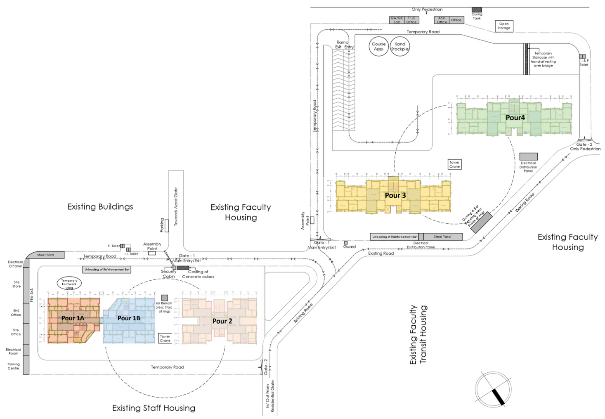
Scope of Work
SCOPE OF WORK
Write specific to the site for example which area are you going to do in the following month etc
Concreting is permitted only after 2 p.m.
S.No | Description | Nos | Quantity | Units
1 | Footings in 1A | 25 | 289 | m²
2 | Footings in 1B | 34 | 407 | m²
3 | Footings in 2 | 10 | 80 | m³
4 | Footings in 3 | 15 | 150 | m³
5 | Footings in 4 | 15 | 150 | m³
6 | Total Footings in xx building or area | 100 | 3090 | m³
608.82 sqm
608.82 sqm
608.82 sqm
608.82 sqm
Write specific to the site for example which area are you going to do in the following month etc
Concreting is permitted only after 2 p.m.
608.82 sqm
Safari Industrial Plant

Slide 3
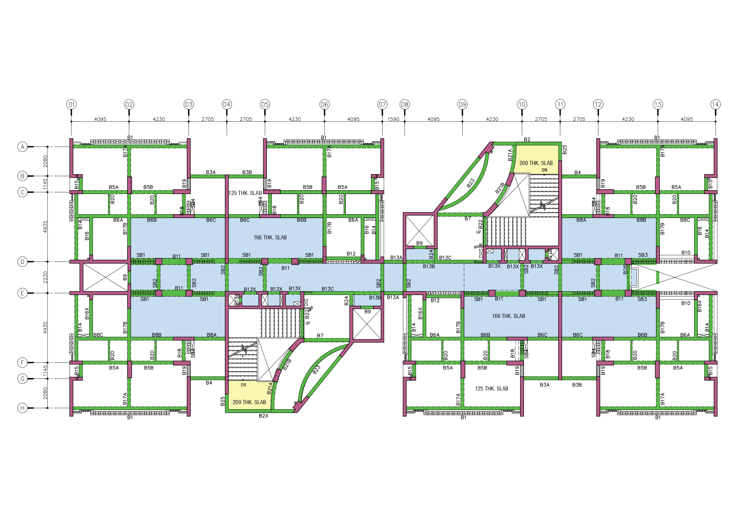

Project Brief
Reasons for Pending
Labour Shortage due to holi festival.
Due to Rain
Due to Steel not available on site.
Etc..
Target for Next Week
Total 12 Footings in block A will be completed.
Excavation in Block B will be done
Landfilling in Block C will be completed.
Completed
Pending
1A
1B
In Progress
Future work
Safari Industrial Plant

Slide 4
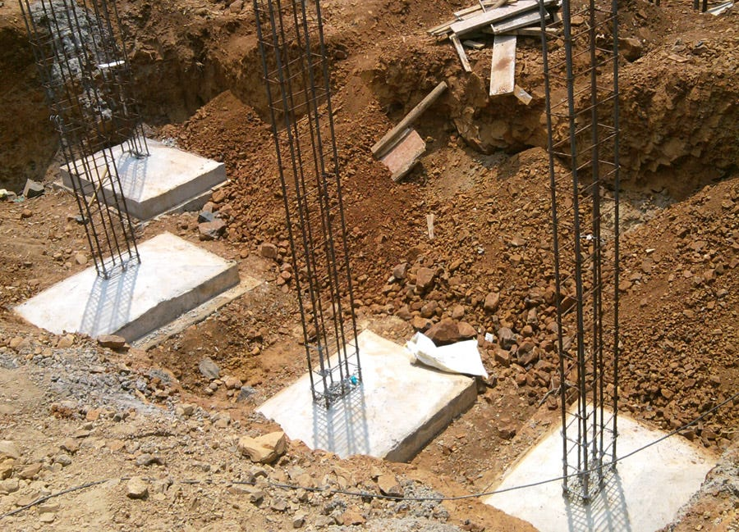
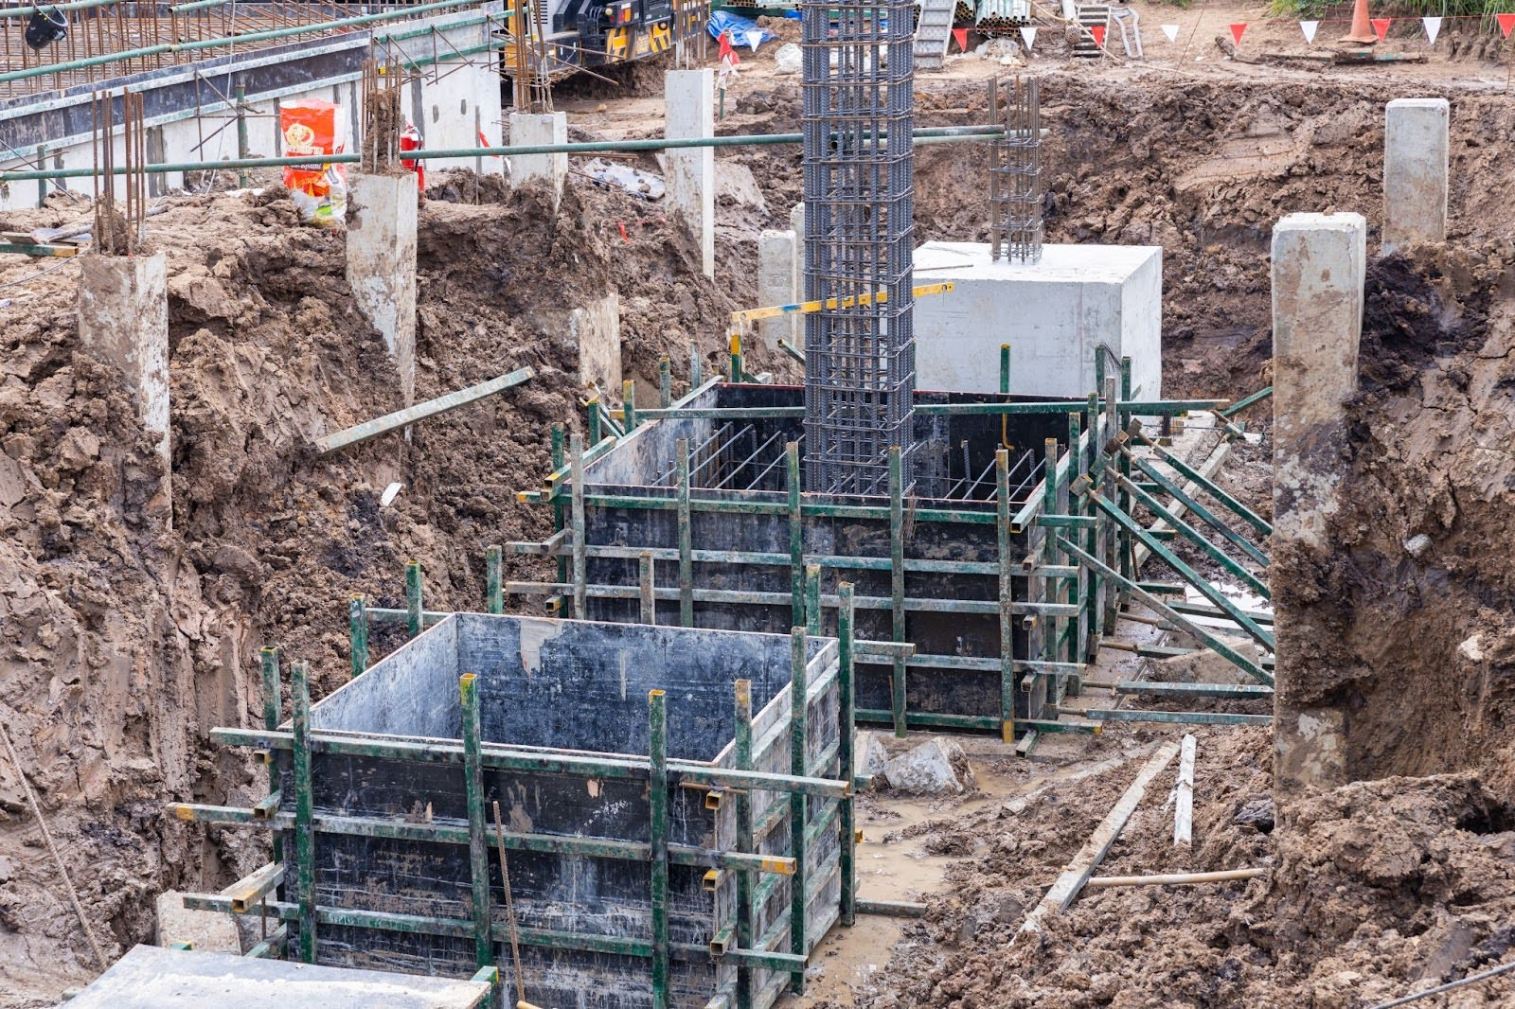
Project Brief
Add Description of image
In Progress
Add Description of image
Safari Industrial Plant

